Slide 1
ListView in Android

Slide 2
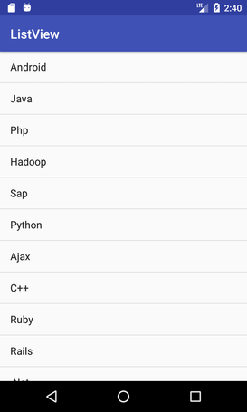
What is ListView
Android ListView is a ViewGroup that is used to display the list of items in multiple rows and contains an adapter that automatically inserts the items into the list.

Slide 3
Example
Step 1: Create a new project
Click on File, then New => New Project.
Choose “Empty Activity” for the project template.
Select language as Java.
Select the minimum SDK as per your need.

Slide 4
Step 2: Modify activity_main.xml file
Add a ListView in the activity_main.xml file.
<?xml version="1.0" encoding="utf-8"?>
<LinearLayout
xmlns:android="http://schemas.android.com/apk/res/android"
xmlns:app="http://schemas.android.com/apk/res-auto"
xmlns:tools="http://schemas.android.com/tools"
android:layout_width="match_parent"
android:layout_height="match_parent"
tools:context=".MainActivity">
<ListView
android:id="@+id/list"
android:layout_width="match_parent"
android:layout_height="match_parent"/>
</LinearLayout>

Slide 5
Step 3: Modify MainActivity.java file

Slide 6
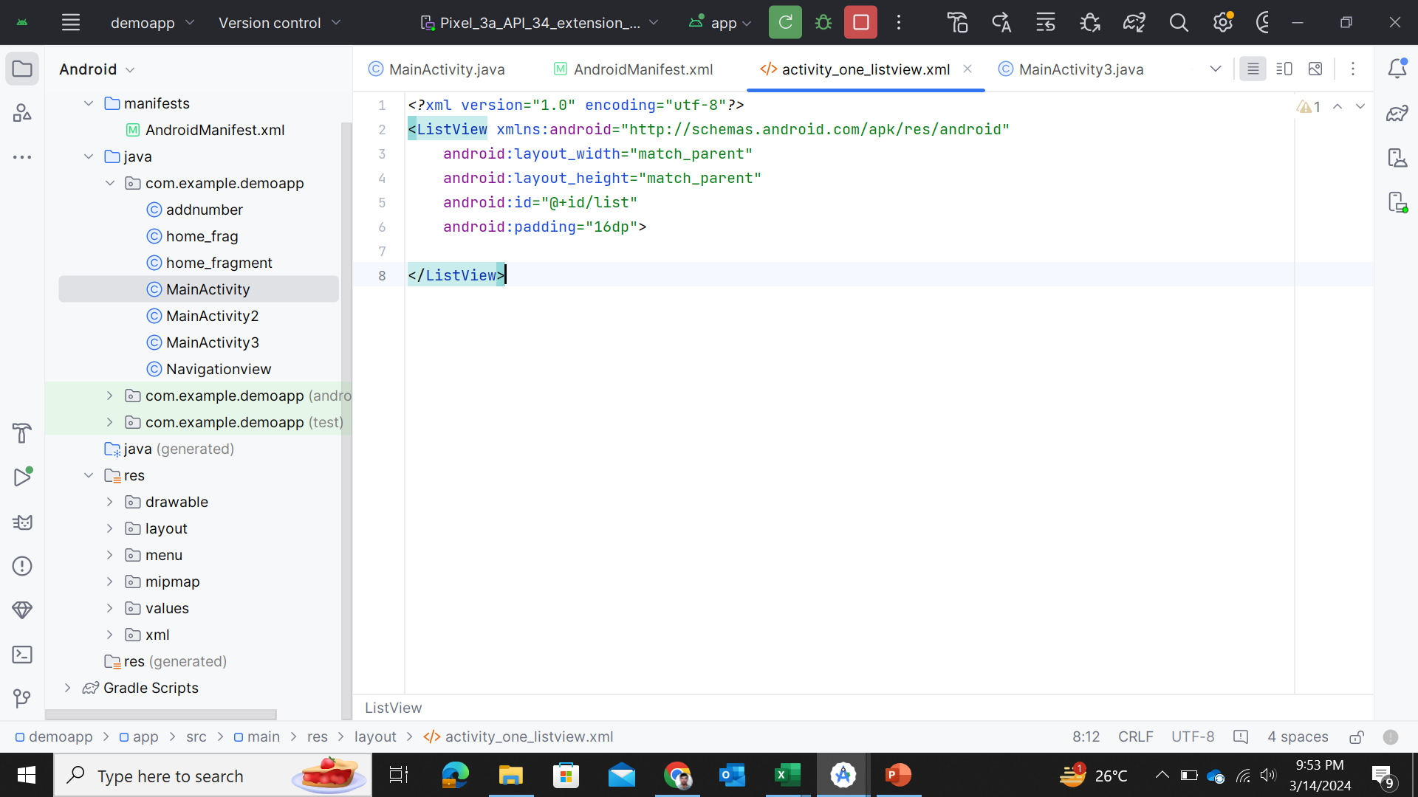
Example 2

Slide 7
